Slide 1
Woodland Public Schools
Facilities and Safety Report
March 2022

Slide 2
Facilities Report
Department training (in person!) – During the pandemic, department training and mandatory training were assigned via safe schools. It was super nice getting the team back together, seeing their faces and introducing new employees to the entire team. We have started our monthly department training in person again for the first time in nearly 2 years!
Spring snow was hard on a couple of trees at WMS. They buckled under the weight of the wet spring snow, and each one lost a significant portion of branches. The grounds team also cut down the last two pin oaks at WMS near the green gym. These (like all the rest), will be replaced with celebration maples. These trees were replaced due to damaging blacktop, lifting sidewalks and possible root damage to a natural gas line.
HVAC ESSER Projects – Received the updated budget for the Yale School this week. Finishing up with the final budget proposal from Trane and other contractors, and plan to submit the package to Stacy and OSPI next week, once the final numbers are checked.

Slide 3
Facilities Report Continued
Spring Break Work – In addition to the normal deep cleaning, our department completed the following projects/items
Completed LED conversion in CES gym
Recoated yellow gym floor at WMS
Restriped WMS track
Took out the last two pin oaks on Park Street, for new celebration maples to be planted
Completed replacement of defective fire sprinklers heads at WMS and CES
Accurate concrete ground sidewalks at WMS in 18 locations to eliminate trip hazards
WMS Greenhouse - We will be finishing up the WMS greenhouse work over the next few weeks. This work included replacing framing and the entire wet deck structure, piping and pump.
Chlorine Analyzer at Yale – Since the Yale Valley Library was placed on the Yale School water system, the system is required to be checked 7 days a week. Since the school is only staffed while school is in session, a chlorine analyzer was ordered to record daily free chlorine levels. This will be installed within the next few days.

Slide 4
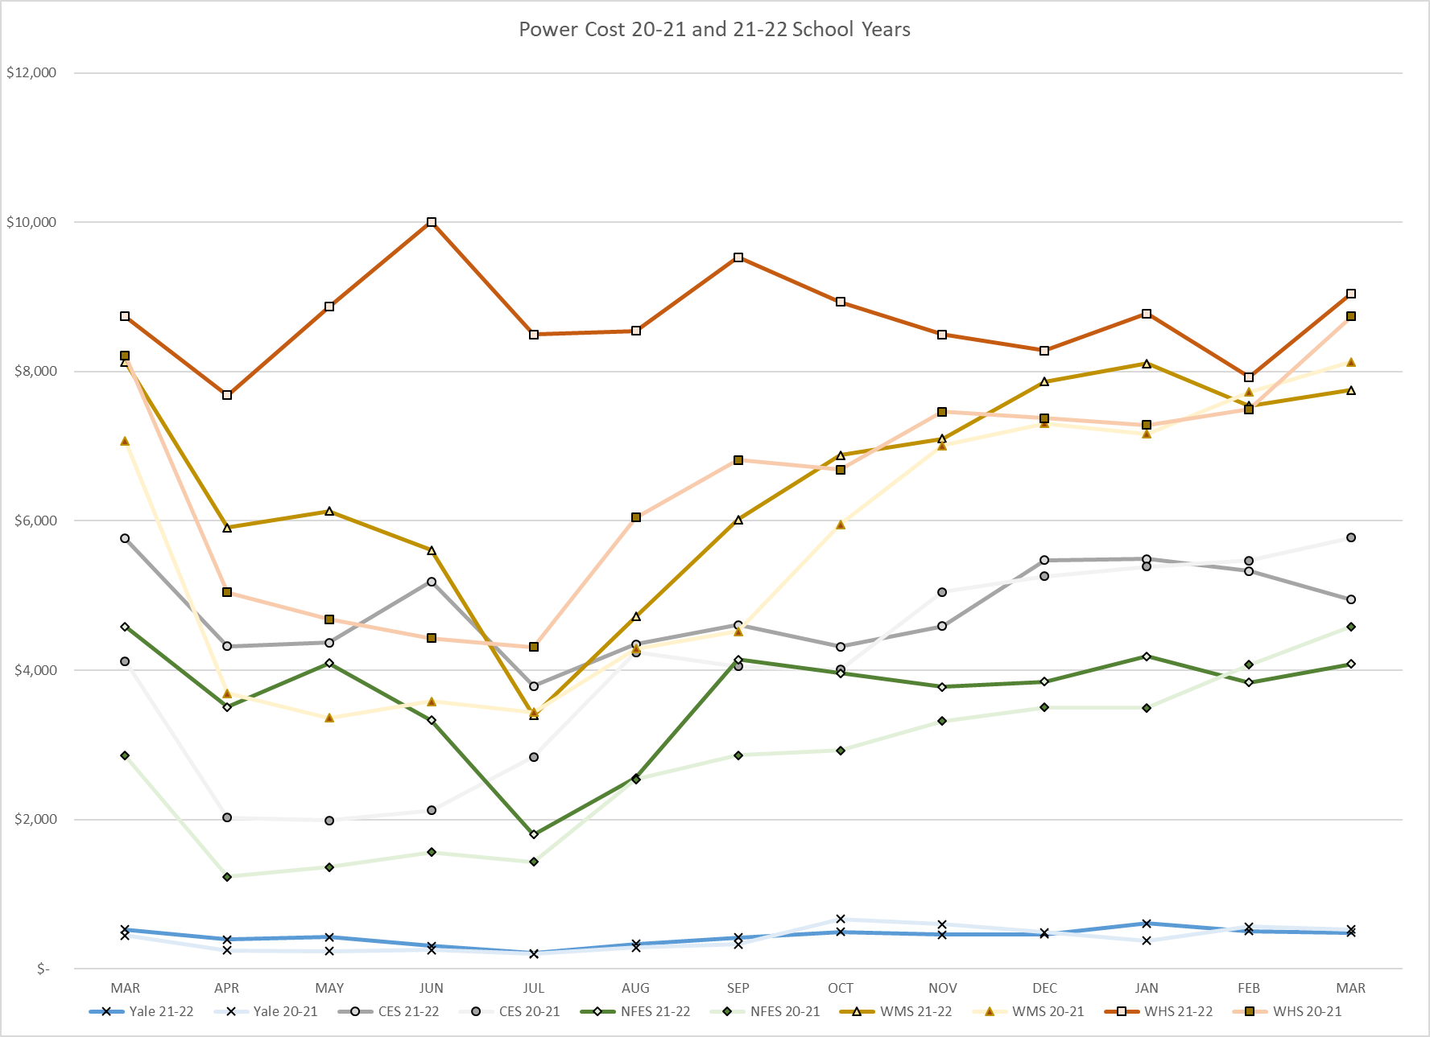
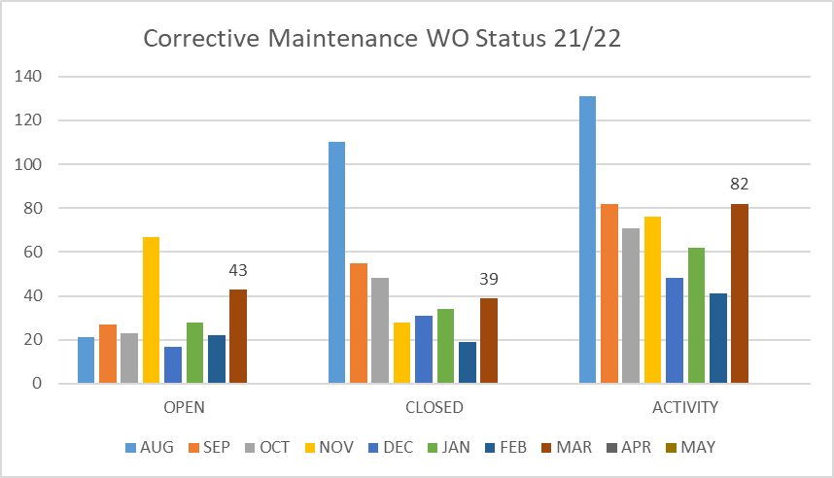
FACILITY CHARTS – POWER COST AND WORK ORDER STATUS

Slide 5
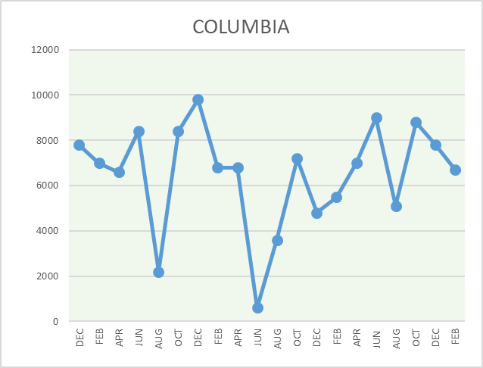
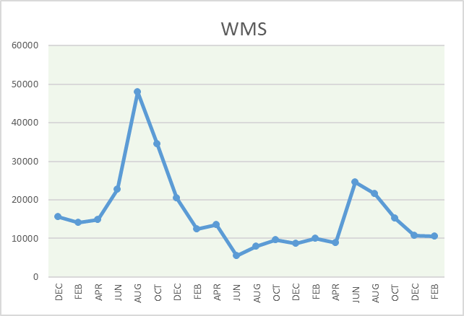
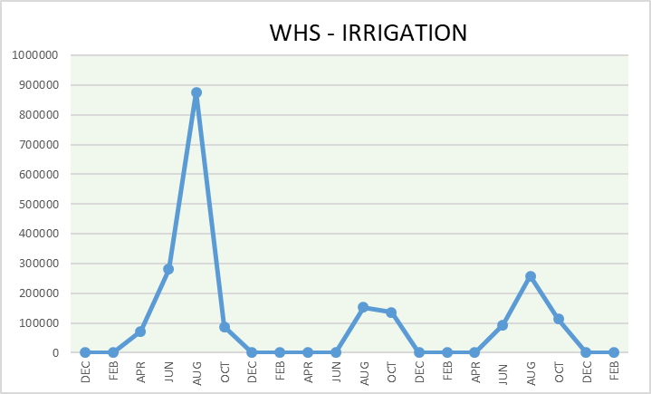
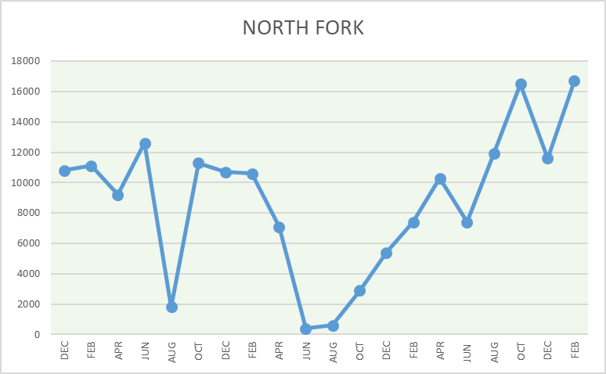
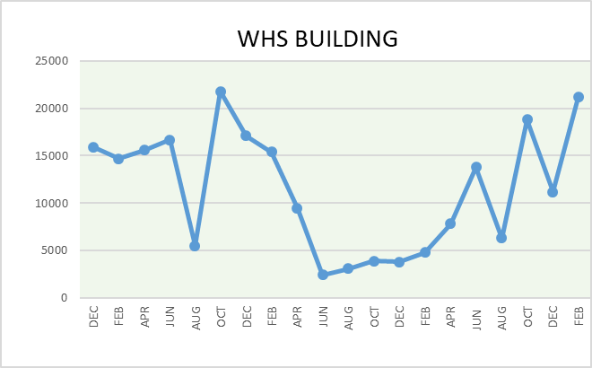
FACILITY CHARTS - WATER USAGE WHS, NFES, WMS, CES
Note
Water charts are updated every two
months. Next update to these charts in the May 2022 report
The WMS chart includes the following 7 meters: 755 Park high and low flow, BO and Team High, PIT house, bus barn, athletic field and DO. All of these meters are totaled on the WMS graph, but each data point is recorded separately to aid in identifying leaks.

Slide 6
Safety Summary Staff and Student Incidents
Staff Accidents/Incidents - 11
Yale - Employee stepped in mole hole and tripped, sprained muscles.
CES - While transitioning SPED student from wheelchair an employee strained back.
WMS - Employee slipped on tile floor when transitioning from the wet outside, sprained ankle.
WHS - Escalated DSP student hit employee causing bruise.
WHS - Escalated DSP student punched and kicked employee causing multiple bruises.
WHS - Escalated DSP student slapped employee – no physical injury.
WHS - Escalated DSP student struck and pulled employees hair causing bruises.
WHS - Escalated DSP student struck employee in the face and arms. No physical injury.
WHS - Escalated DSP student bit employee while being changed, bruised.
WHS - Escalated DSP student hit multiple employees, multiple times and bit also, bruised.
WHS - Escalated DSP student pulled employees hair and hit multiple times , bruised.
Student Accidents/Injuries - 3
CES - Student stubbed toe on slide, broke 2nd toe.
CES - (WCC) Student got elbow stuck in rails, tender and sore elbow.
WHS - Student misjudged pole vault bent knee inward, sprained knee.

